Slide 1
Introduction to Ingot Niobium
Andrew Hutton
SSTIN10 Symposium
Jefferson Lab
Sept 22-24, 2010

Slide 2
Overview
Introduction to CEBAF
Historical perspectives on ingot niobium – 1970’s
Reintroduction of ingot niobium - 2004
Conclusions

Slide 3
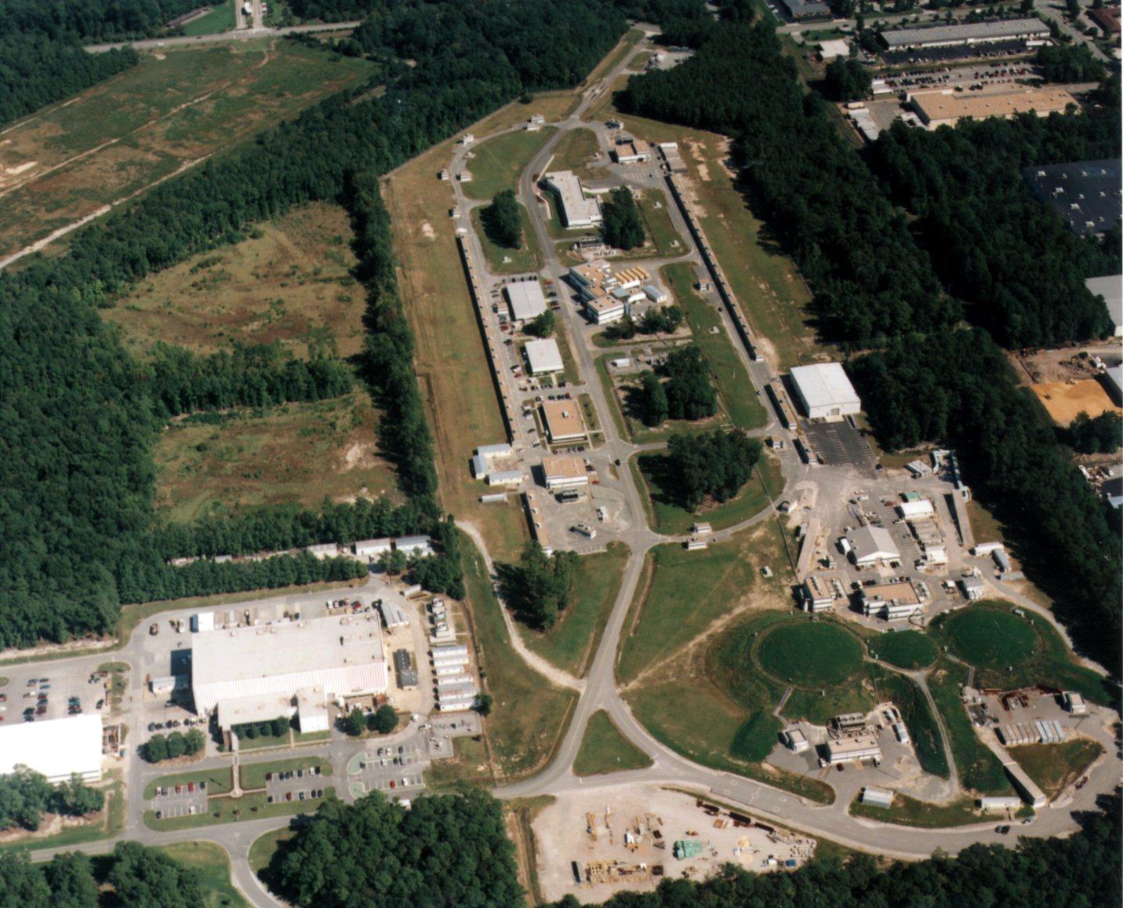
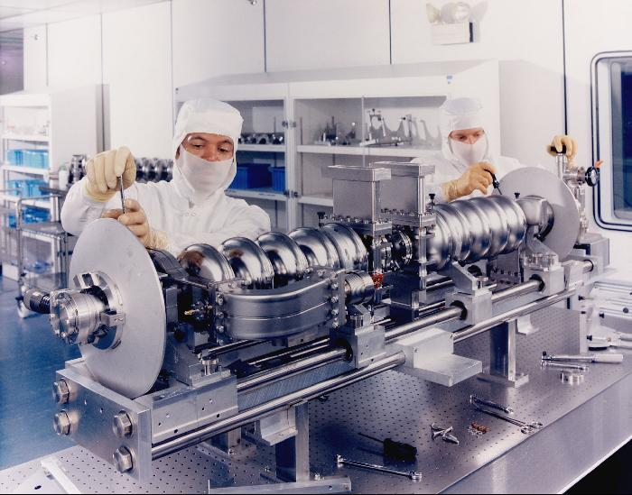
Jefferson Lab Accelerator Site
CEBAF
SRF recirculating linac
Test Lab at the Institute for Superconducting Radio-Frequency
Science and Technology
SNS drive linac
JLab - FEL
FEL
Nuclear Physics
Detector
Halls A, B, C

Slide 4
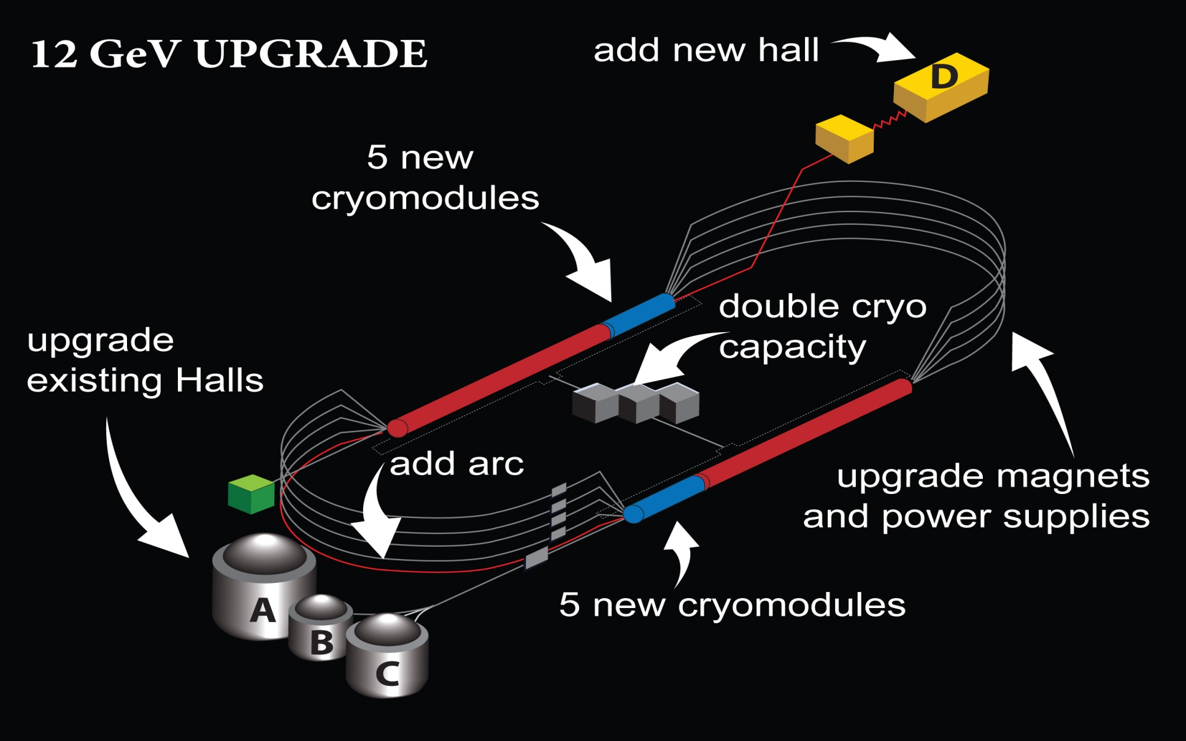
CEBAF energy upgrade

Slide 5
Highlights of Early SRF Technology
Cavities were mostly made from ingot niobium
  Process and procedures were similar and as varied as today
Reactor grade Niobium material in ingot, bar, plate sheet and tube form was available
Achievable gradient limited by multipacting and/or field emission
Residual surface resistance (nΩ) was not well understood
  Still the case
At highest frequencies (Electropolished fine grain, X-band) Hpk ~ 159 mT Q0 ~5x109
(BCP’d ingot Nb, 1970’s) Hpk ~ 108 mT & Q0 ~1×1011 @ 1.2 K CW
For comparison (CEBAF upgrade spec.) Hpk ~ 92 mT Q0 ~ 7×109 @ 2 K CW (2008)

Slide 6
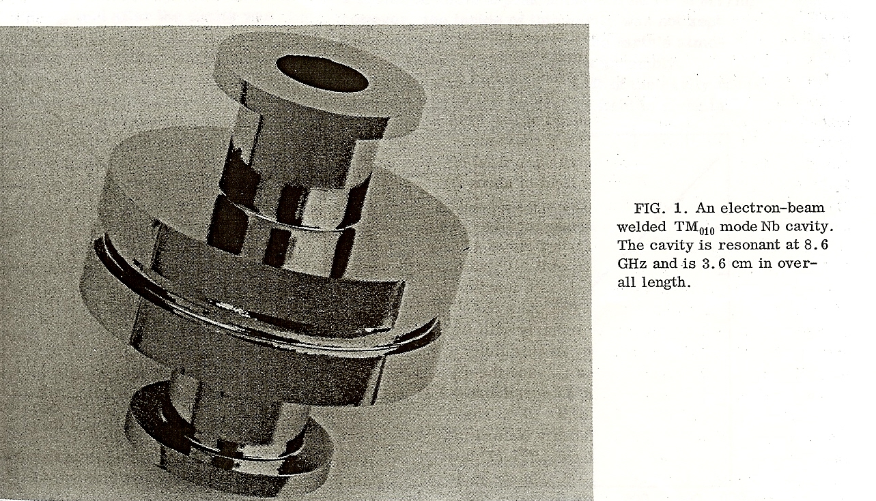
Historical Example of Ingot Niobium 1
H_{pk}~ 108 mT with BCP
Stanford solid niobium cavity 1970

Slide 7
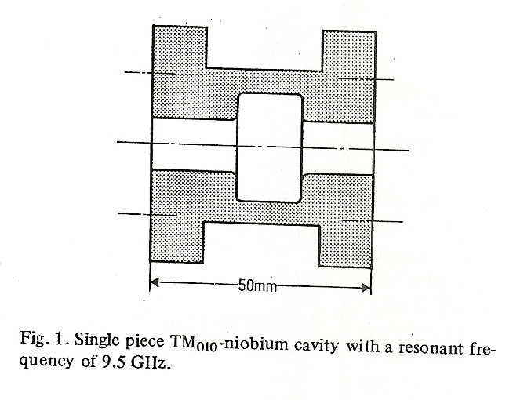
Historical Example of Ingot Niobium 2
H_{pk}~ 109 mT with BCP
H_{pk}~ 130 mT with EP
Siemens solid niobium cavity 1973

Slide 8
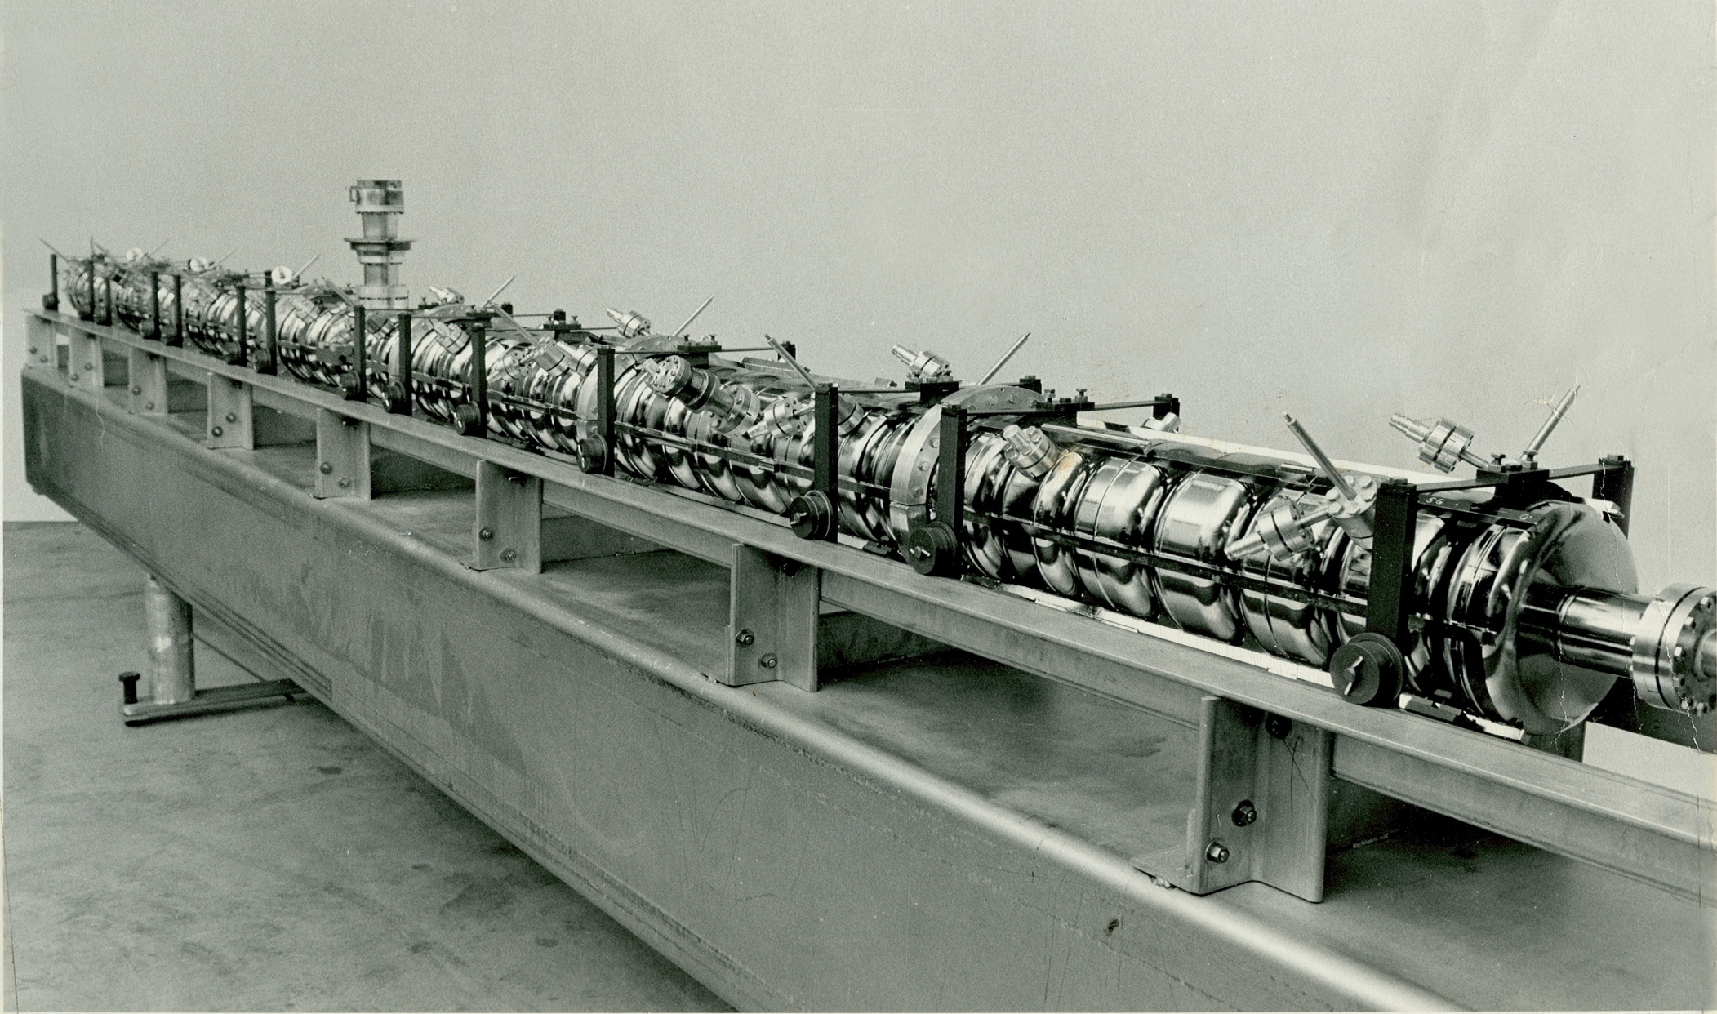
UIUC HEPL 49 Pill Box 1.3 GHz Cavities
Cavities were machined from low purity ingots
Final step was ~1800 ºC vacuum anneal to reduce
residual stress
H_{pk}/E_{acc} ~ 3
Photo Courtesy of Larry Cardman
Gradient limitation was considered to be due to inadequate cleaning
  Surface recontamination from dirty vacuum systems was not thought to be important
Shape was changed to elliptical H_{pk}/E_{acc} ~ 4.7 (CEBAF Cavities)
Polycrystalline Niobium became the material of choice

Slide 9

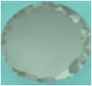
Birth of Ingot Niobium Technology
CBMM/RMCI-JLab CRADA, August 2004
September 2004
Chosen for Excellent Ductility and Surface Smoothness with just BCP
First CBMM/JLab International Patents were applied for in April, 2005

Slide 10
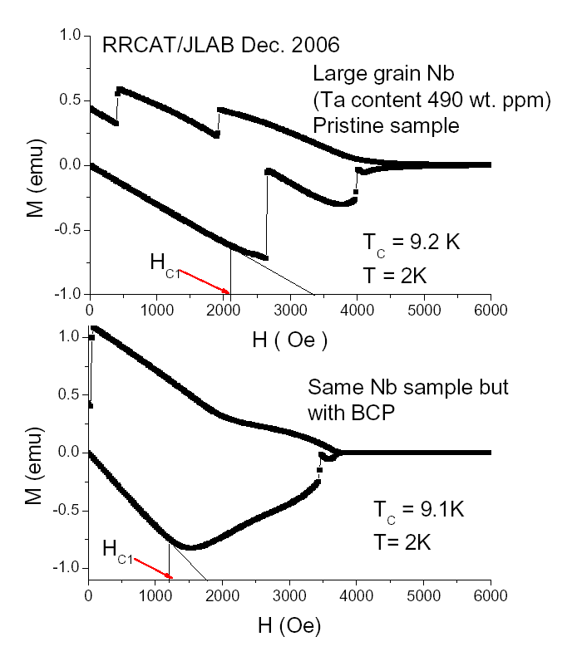
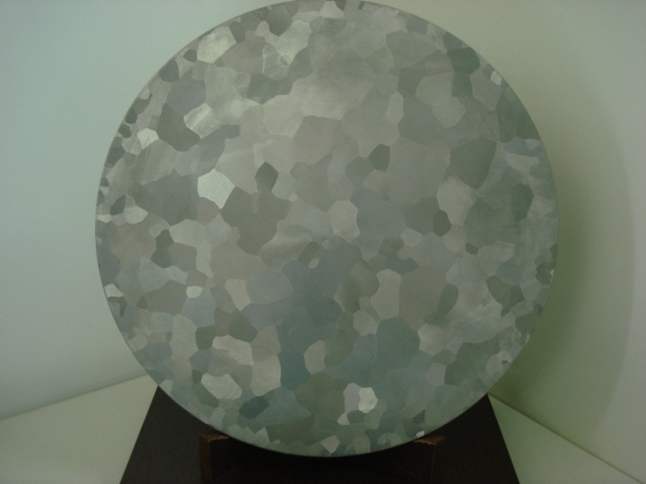
Performance independent of RRR and Vendor
CBMM Ingot E Eacc ~ 36 MV/m
H_{pk}~153 mT
H_{ffp} > 210 mT
RRCAT/JLab
H_{ffp} ~ 140 mT
RRCAT/JLab
“On the reliable determination of the magnetic field for first flux-line
penetration in technical niobium material”
S. B. Roy, G. R. Myneni and V. C. Sahani,
Superconductor Science and Technology. 21 (2008) 065002
Ingot Nb from 3 vendors perform equally well even with un-optimized processes H_{pk} 140 – 160 mT
Poly Nb H_{ffp} < 180 mT
With BCP H_{ffp} < 100 mT

Slide 11
Figure of merit of large & fine grain Niobium
Figure of merit is the product of (Eacc* Qo) at the quench limit
Currently magneto thermal quench limits the performance
Large grain ingot niobium
Polycrystalline niobium

Slide 12
Ingot niobium collaborations
Optimize the Nb treatment parameters in order to maintain the superconducting properties of the pristine Niobium (NIST, RRCAT and BARC)
Eliminate the surface oxide layer, remove the dissolved hydrogen and implant nitrogen to form mono layers of Niobium Nitride to passivate the surface and enhance the performance from the proximity effect (Casting Analysis Corp., ODU, NCSU, and W&M)
Develop a clean UHV furnace with induction heating to eliminate contamination of cavity surfaces and avoid the final chemistry (Casting Analysis Corporation)

Slide 13
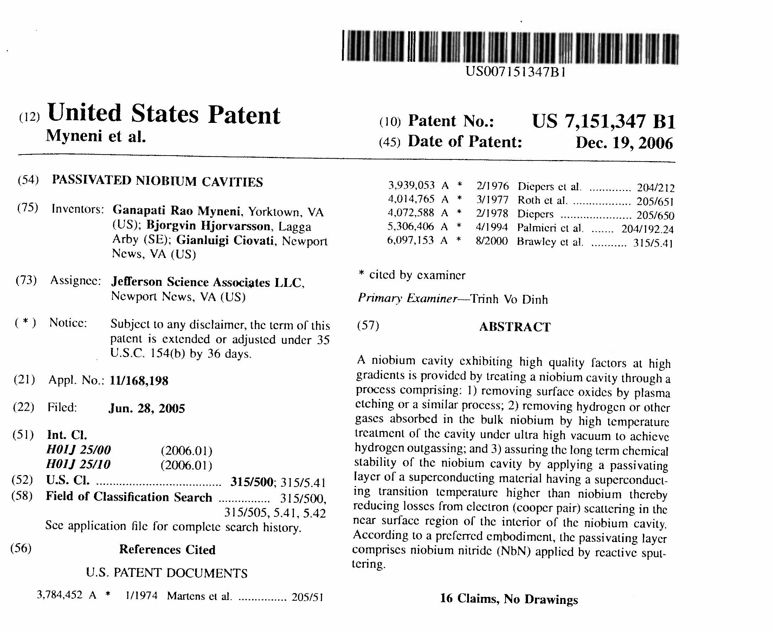

Slide 14
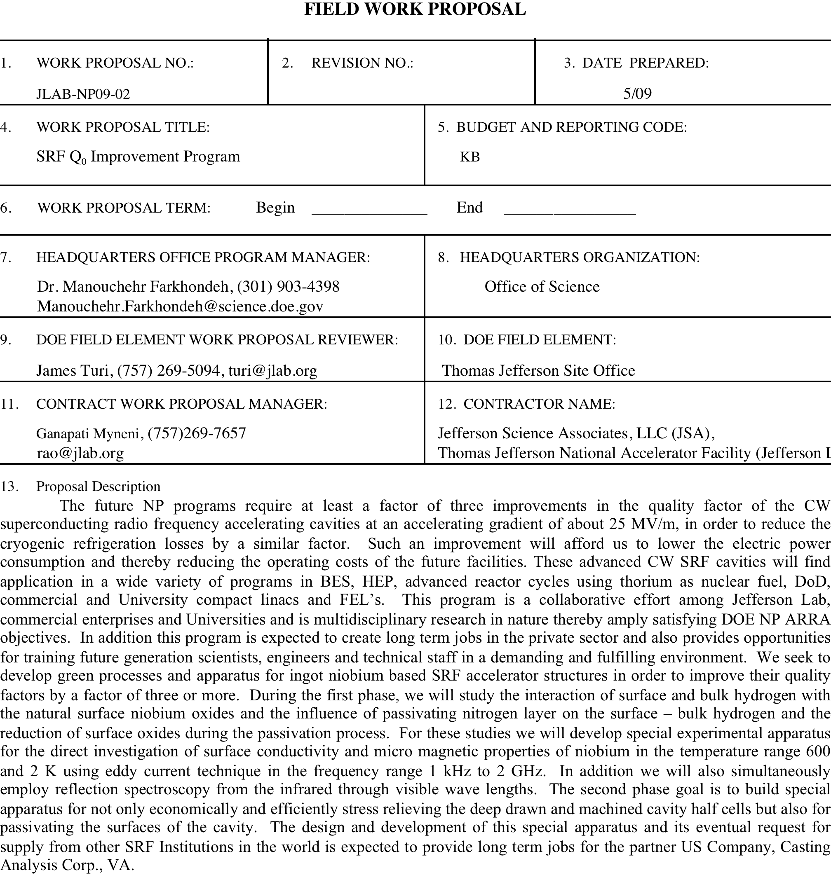

Slide 15
Conclusions
JLab introduced ingot niobium technology and has reconfirmed the high quality factors and peak magnetic fields found with low RRR solid niobium in the 1970’s
High tantalum in ingot niobium is not expected to negatively impact the performance of the cavities but will reduce the cost of accelerator structures considerably
Optimized low cost CW linacs built with ingot niobium will pave the path for future R&D and industrial applications

Slide 16
R&D on Ingot Niobium Continues
The next talks will highlight progress on three continents
R&Ds in Asia on large/single crystal niobium after the international niobium workshop 2006
  Kenji Saito
Advances in large grain resonators activities at DESY, W.C. Heraeus and RI
  Waldemar Singer
America's overview of superconducting science and technology of ingot niobium
  Gigi Ciovati

